Slide 1
Tree Variants

Slide 2
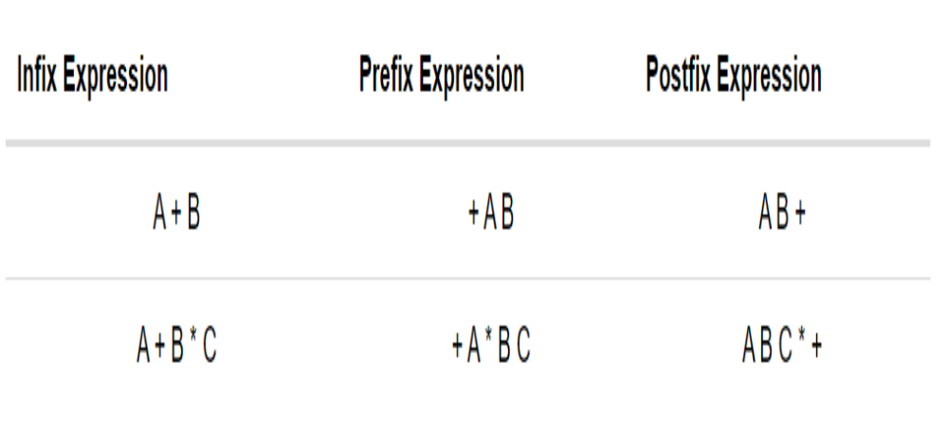
Infix, Prefix and Postfix expressions

Slide 3
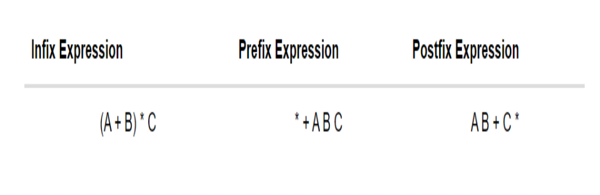

Slide 4
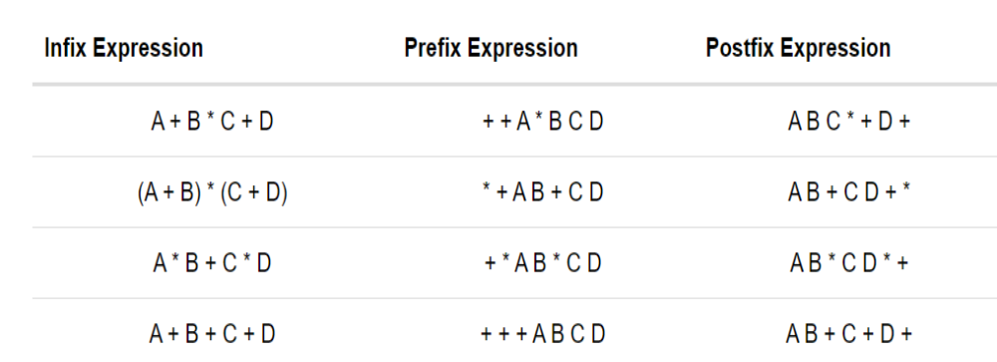

Slide 5
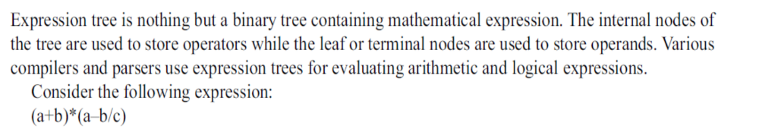
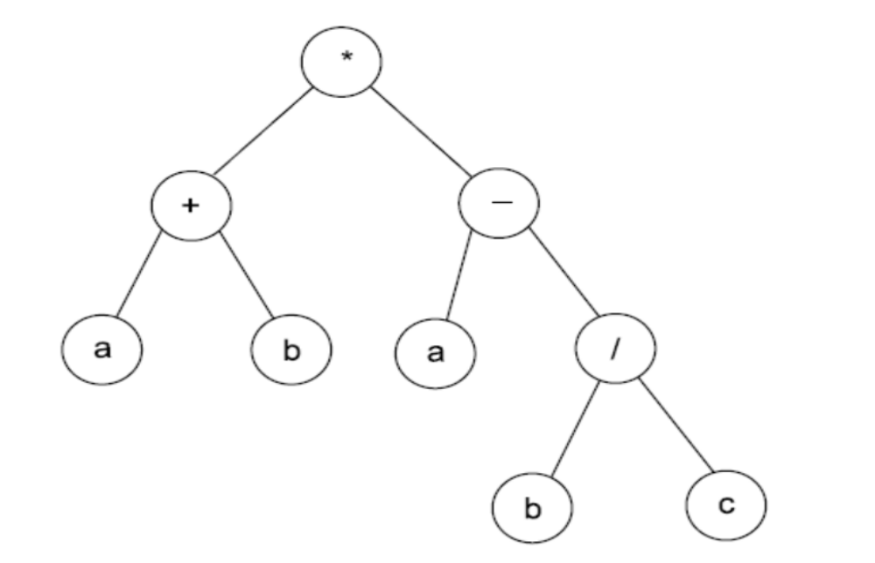
Expression Trees

Slide 6
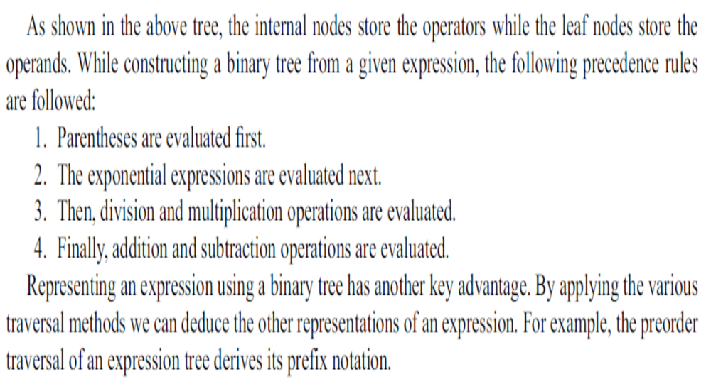

Slide 7
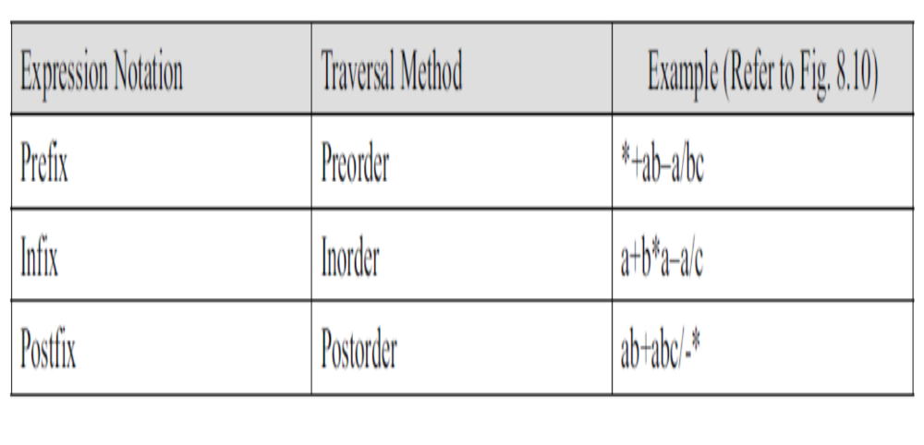

Slide 8
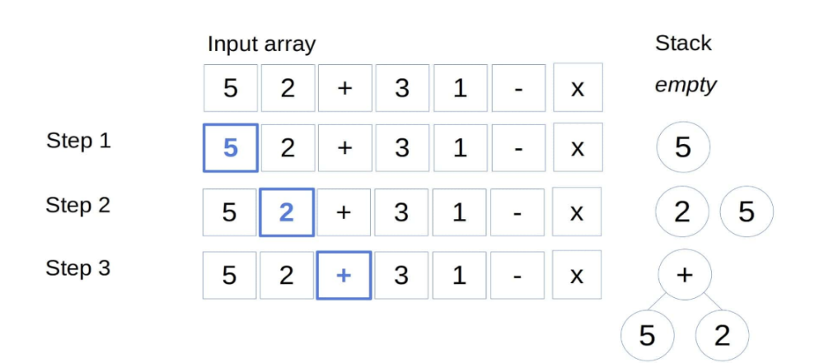
5 2 + 3 1 - x

Slide 9
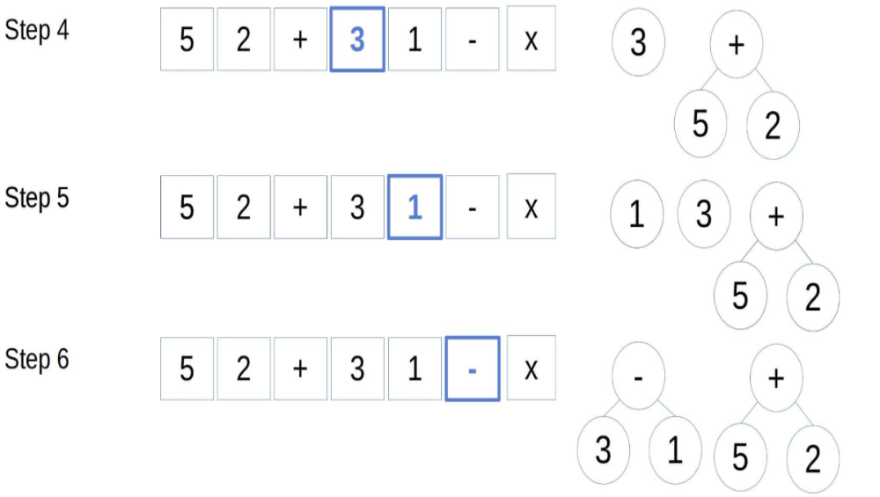

Slide 10
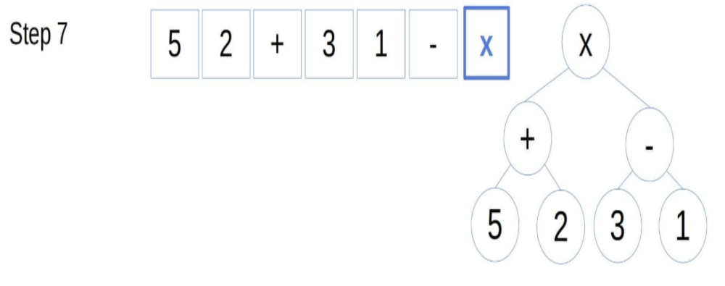

Slide 11
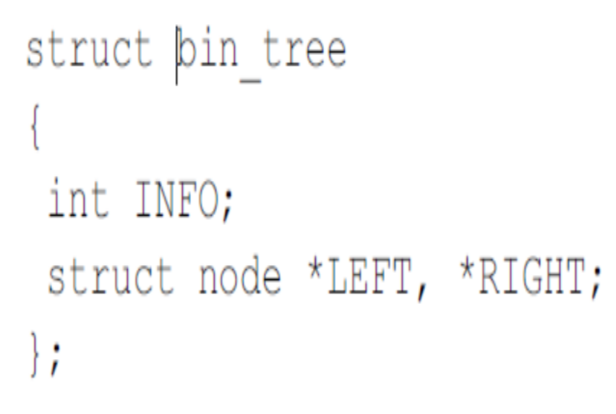
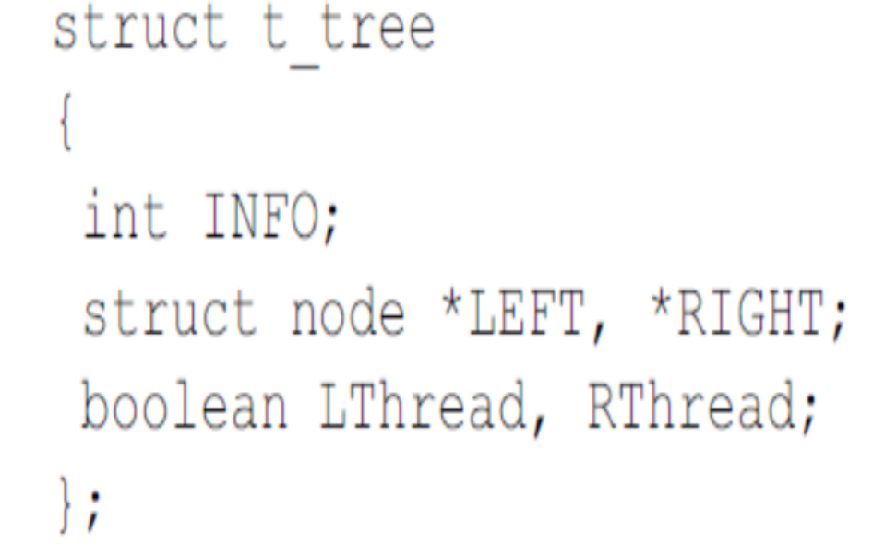
Threaded Binary Trees

Slide 12
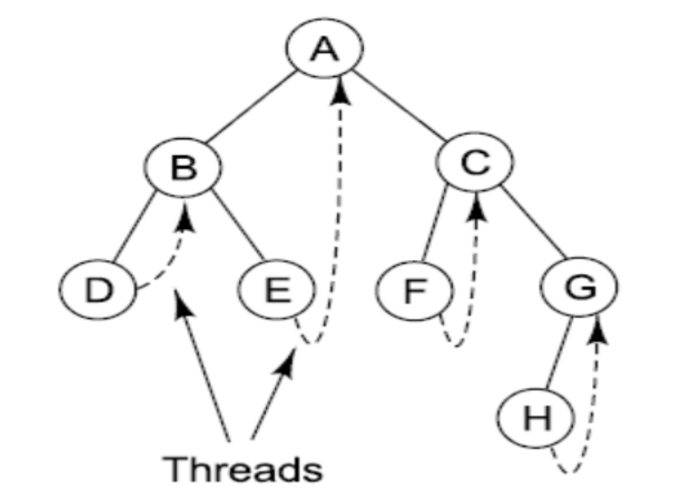

Slide 13
Graphs
What is Graph?
A graph data structure is a collection of nodes (also called vertices) and edges that connect them. Nodes can represent entities, such as people, places, or things, while edges represent relationships between those entities.
Graphs are used to model a wide variety of real-world systems, such as social networks, transportation networks, and computer networks.

Slide 14
What is Tree?
A tree data structure is a hierarchical data structure that consists of nodes connected by edges. Each node can have multiple child nodes, but only one parent node. The topmost node in the tree is called the root node.
Trees are often used to represent hierarchical data, such as file systems, XML documents, and organizational charts.

Slide 15
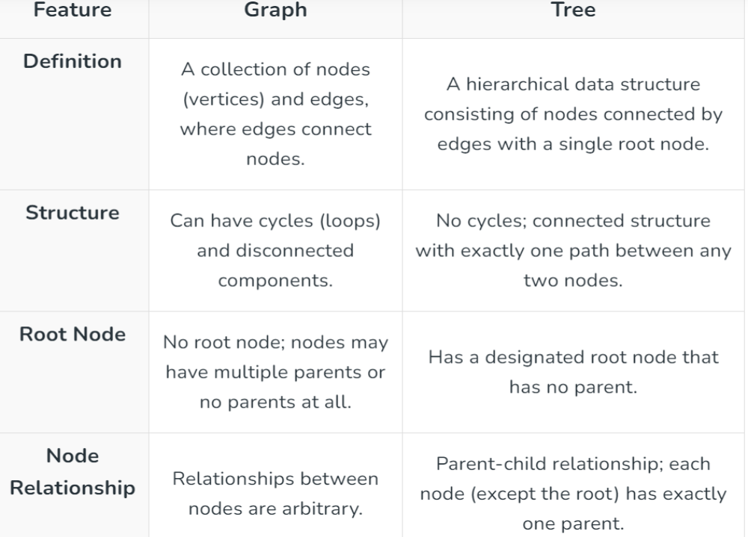

Slide 16
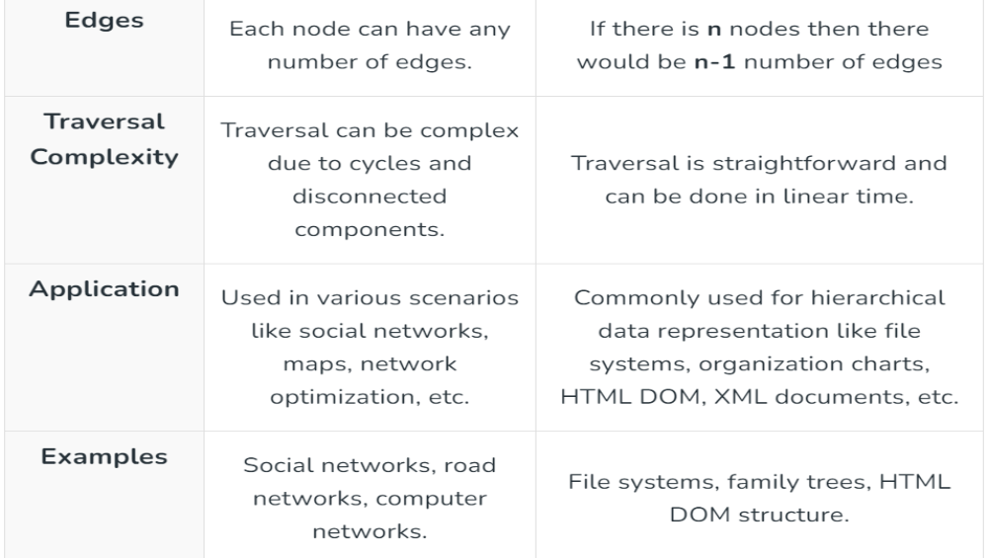

Slide 17
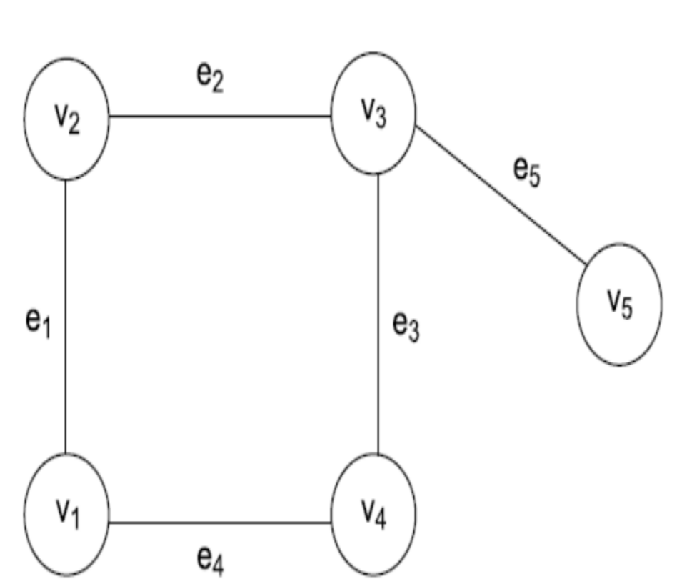
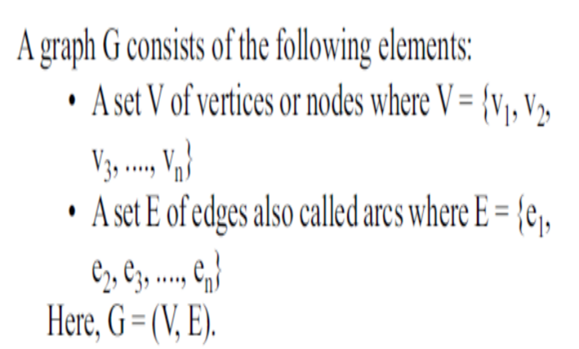

Slide 18
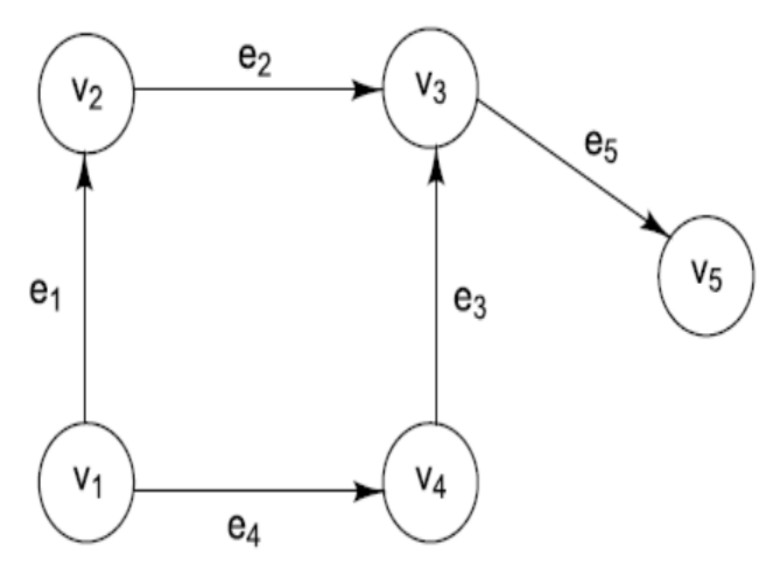
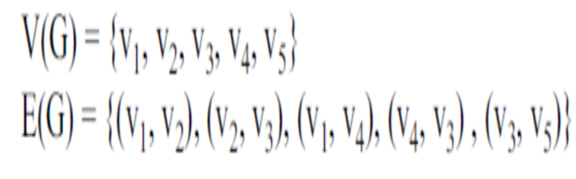
Directed Graph/Diagraph

Slide 19
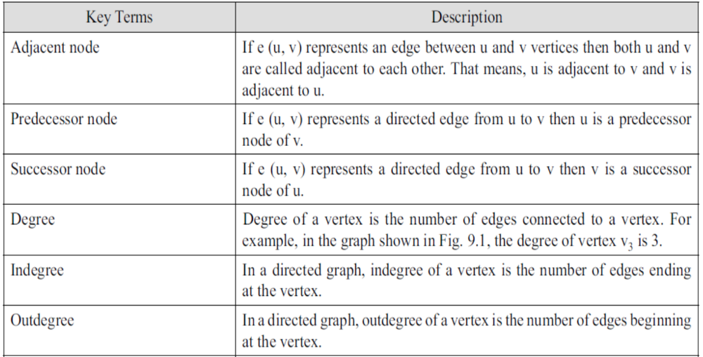
GRAPH TERMINOLOGY

Slide 20
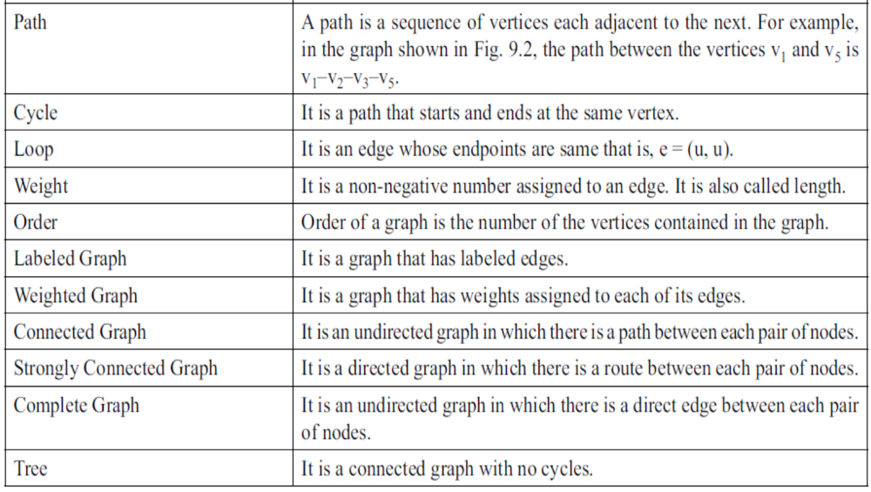

Slide 21
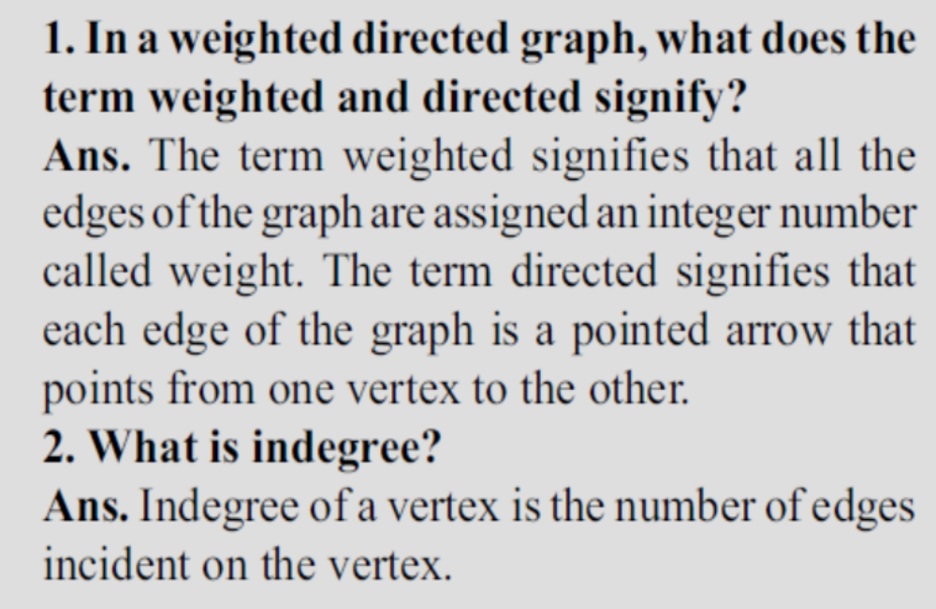

Slide 22
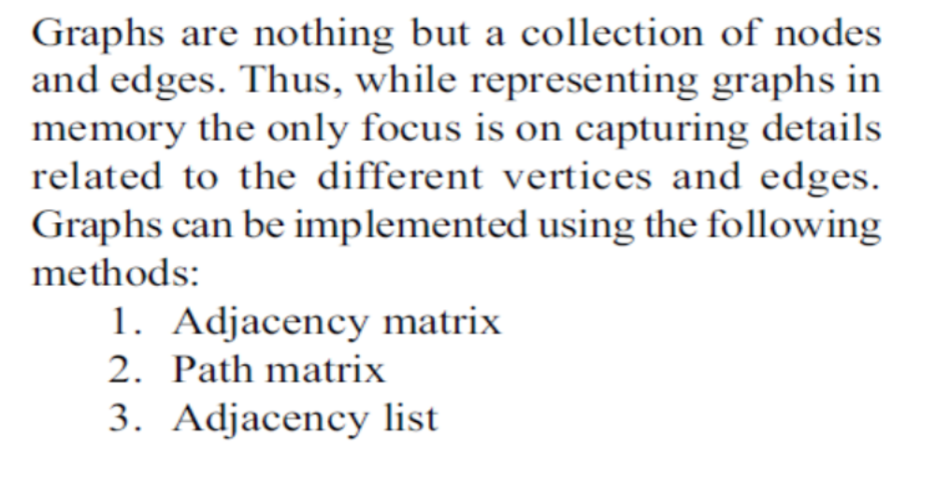
GRAPH IMPLEMENTATION

Slide 23
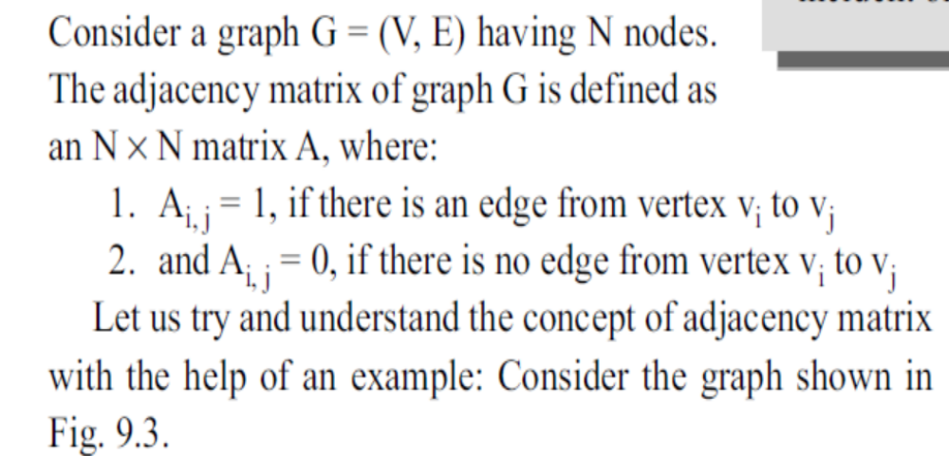
Implementing Graphs Using Adjacency Matrix

Slide 24
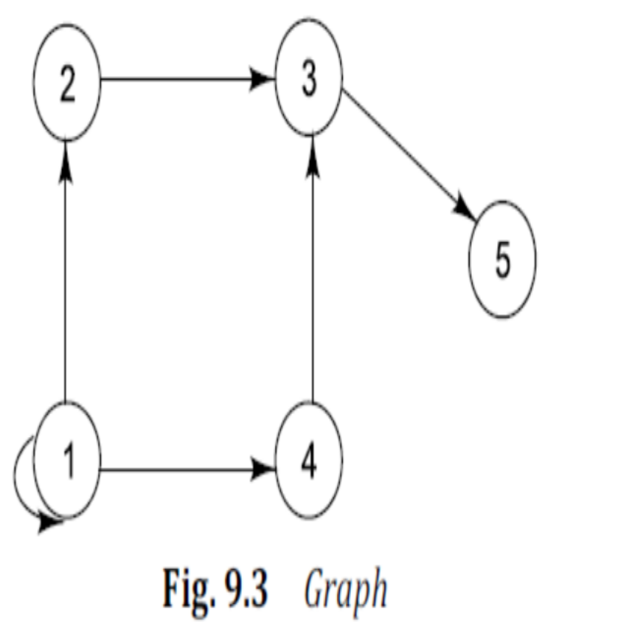
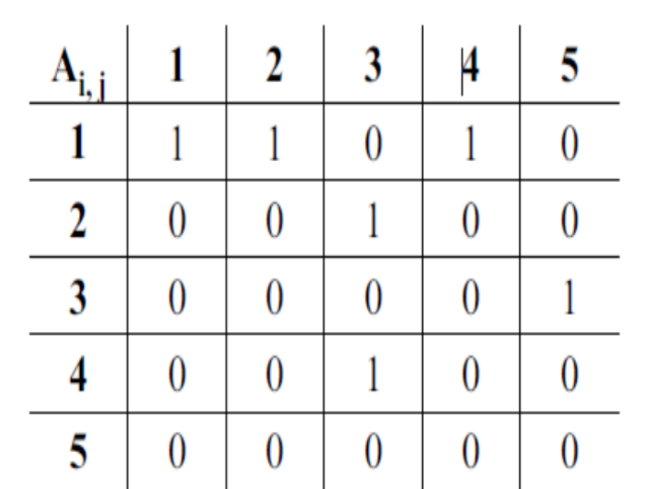
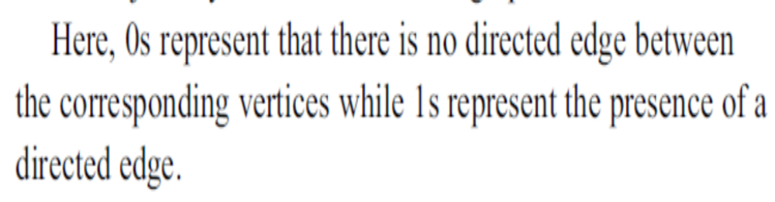

Slide 25
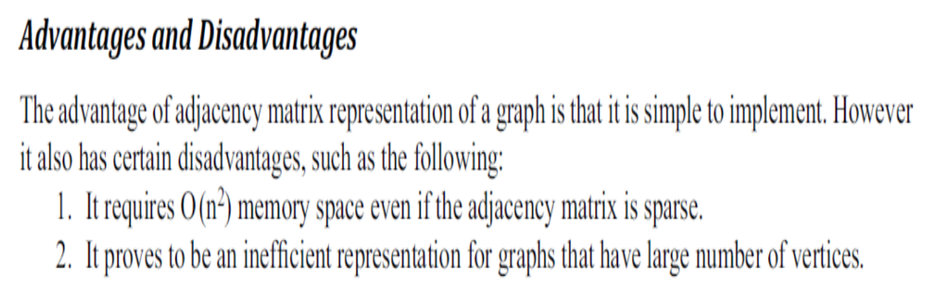

Slide 26
Write a program in C to represent a graph using adjacency matrix.
#include <stdio.h>
int main()
{
int iaGraph[10][10], iNum, i, j;
printf("\nEnter the number of Vertices : ");
scanf("%d", &iNum);
printf("\nEnter the edges of the graph (1 if edge exists and 0 otherwise) : \n");
}

Slide 27
for(i=0; i<iNum; i++)
{
for(j=0; j<iNum; j++)
{
printf("\nEdge b/w vertex %d and %d : ", i+1, j+1);
scanf("%d", &iaGraph[i][j]);
}

Slide 28
printf("\nThe adjacency matrix of the entered graph is :\n");
for(i=0; i<iNum; i++)
{
for(j=0; j<iNum; j++)
{
printf("%d\t", iaGraph[i][j]);
}
printf("\n");
}
return 0;
}

Slide 29
output
Enter the number of Vertices : 3
Enter the edges of the graph (1 if edge exists and 0 otherwise) :
Edge b/w vertex 1 and 1 : 0
Edge b/w vertex 1 and 2 : 1
Edge b/w vertex 1 and 3 : 1

Slide 30
Edge b/w vertex 2 and 1 : 0
Edge b/w vertex 2 and 2 : 0
Edge b/w vertex 2 and 3 : 1
Edge b/w vertex 3 and 1 : 0
Edge b/w vertex 3 and 2 : 1
Edge b/w vertex 3 and 3 : 0
The adjacency matrix of the entered graph is :
0 1 1
0 0 1
0 1 0

Slide 31
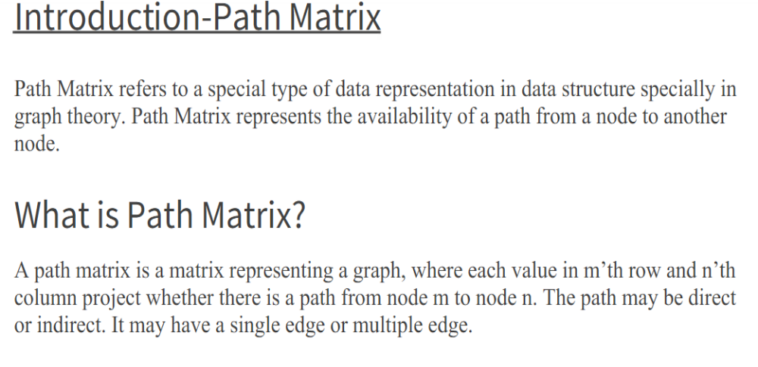
Implementing Graphs Using Path Matrix

Slide 32
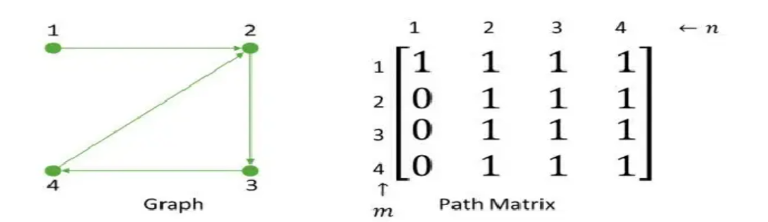
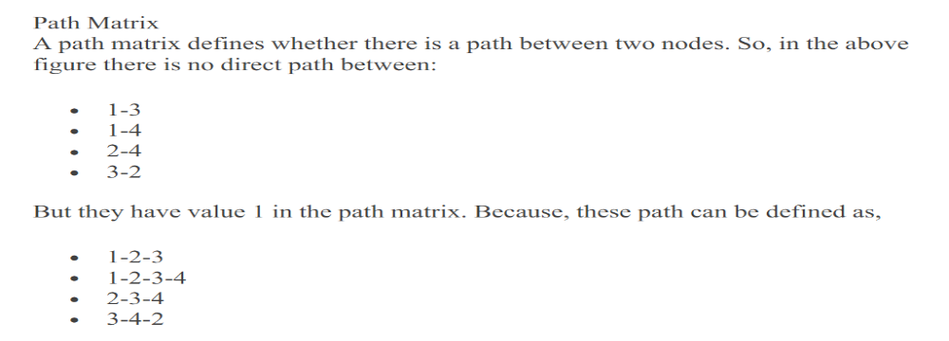

Slide 33
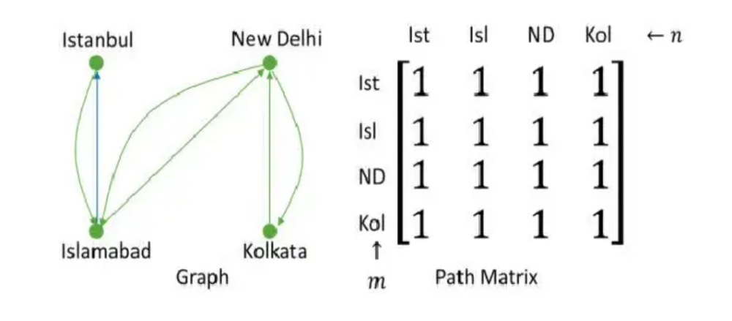
Real Life Example

Slide 34
Write a program in C to represent a graph using path matrix.
#include <stdio.h>
const int MAX = 100;
void WarshallTransitiveClosure(int graph[MAX][MAX], int numVert)
{ int i,j,k;
for (k=0; k<numVert; k++)
{ for (i=0; i<numVert; i++)
{ for (j=0; j<numVert; j++)
{ if (graph[i][j] || (graph[i][k] && graph[k][j]))
graph[i][j] = 1;
} } } }

Slide 35
int main()
{
int i, j, numVert;
int graph[MAX][MAX];
printf("Enter the number of vertices : ");
scanf("%d",&numVert);
printf("Enter the adjacency matrix :-\n");
for (i=0; i<numVert; i++)
for (j=0; j<numVert; j++)
scanf("%d",&graph[i][j]);
WarshallTransitiveClosure(graph, numVert);

Slide 36
printf("\nThe Path Matrix for the given graph is :-\n");
for (i=0; i<numVert; i++)
{
for (j=0; j<numVert; j++)
{
printf("%d\t",graph[i][j]);
}
printf("\n");
}
return 0;
}

Slide 37
output
Enter the number of vertices : 3
Enter the adjacency matrix :-
1 0 1
0 0 1
1 1 1
The Path Matrix for the given graph is :-
1 1 1
1 1 1
1 1 1

Slide 38
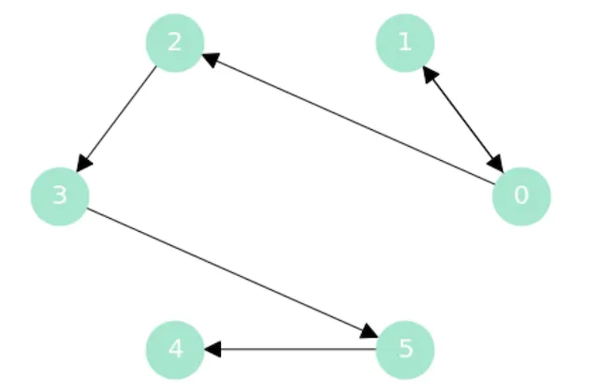
1 is only directly connected to 0, but
If 1 is connected to 0, and 0 is connected to 2, then there is a second level connection between 1 and 2. Next we see that 2 is connected to 3, so we can get from 1 to 3, through third level connection.
By doing this for each and every node in our original set we get transitive closure. But imagine if we had thousands of nodes and connections between them. This isn’t scaling very well, is it? Imagine we had thousands or even millions of nodes and connections and we want to get transitive closure. This could take a lot of computational power, but here is where Warshalls algorithm come in handy.

Slide 39
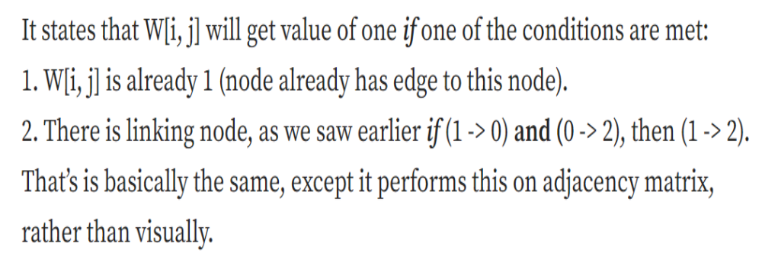
Warshall Algorithm

Slide 40
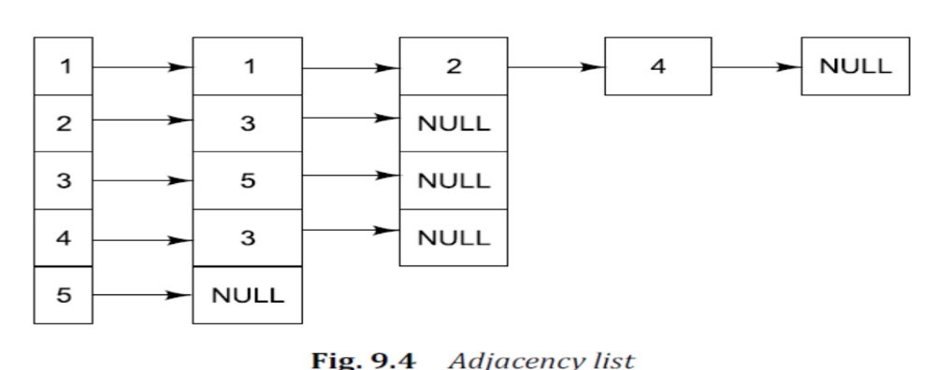
Implementing Graphs Using Adjacency List
Adjacency list is a linked representation of a graph. It consists of a list of graph nodes with each node itself consisting of a linked list of its neighboring nodes.

Slide 41
SHORTEST PATH ALGORITHM
One of the most common problems associated with graphs is to find the shortest path from one node to the other.
It finds its relevance in a number of real-life applications.
For example, consider a scenario where a freight carrier departing from Delhi is required to drop consignments at Lucknow, Jaipur, Ahemadabad, Pune, and Hyderabad airports.
In this situation, the route taken by the carrier is determined by assessing the distance between each of these cities. The final route undertaken should be the shortest path that covers all these cities. We can relate this scenario with a graph data structure where each city represents a graph node while the distance between the cities represents the weight of the edges.

Slide 42
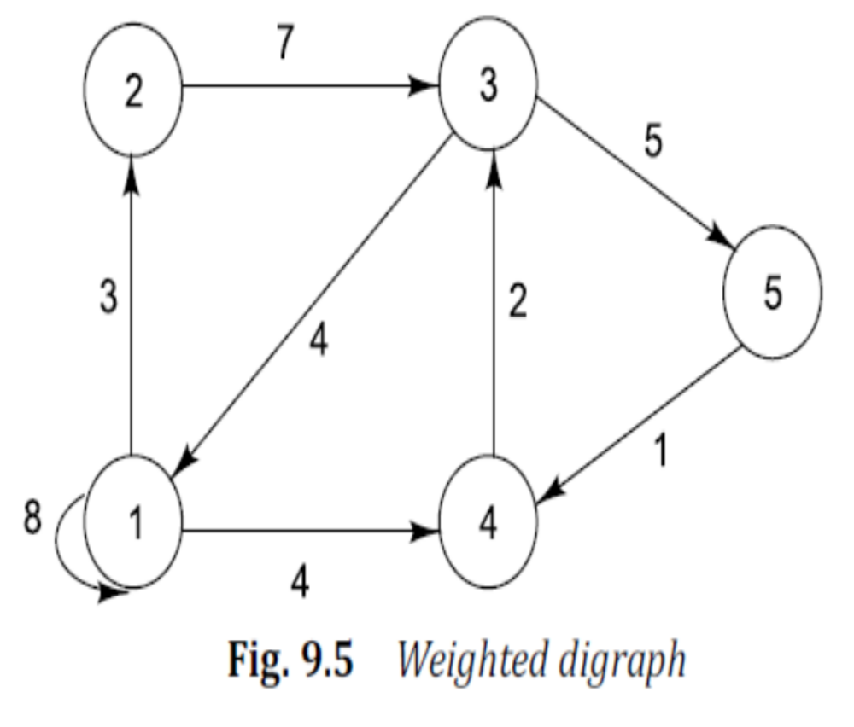
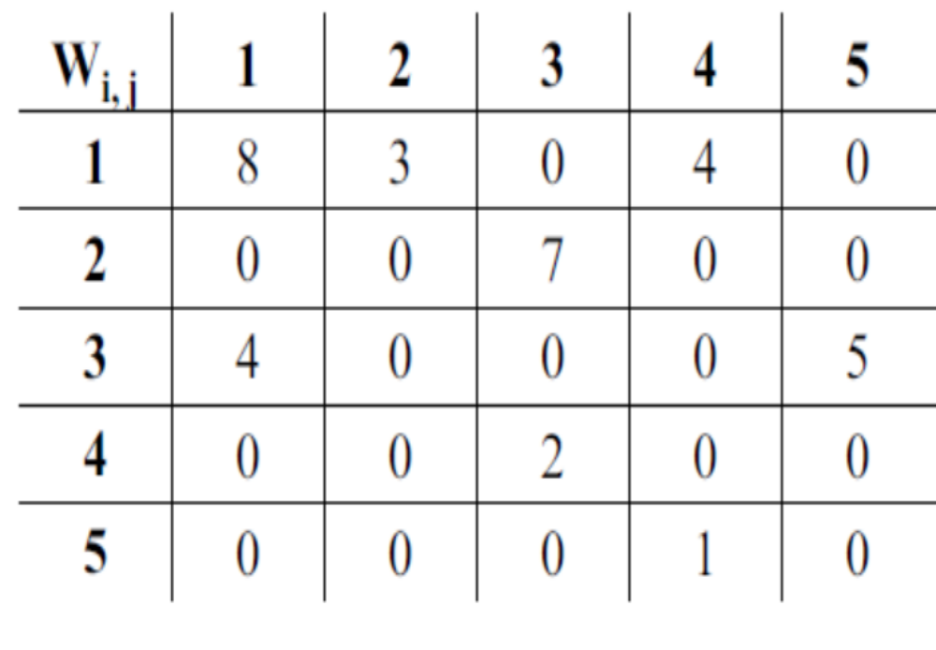

Slide 43
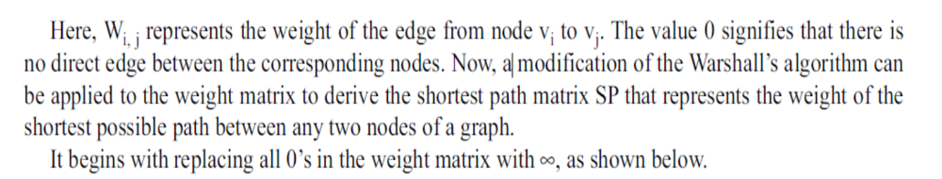
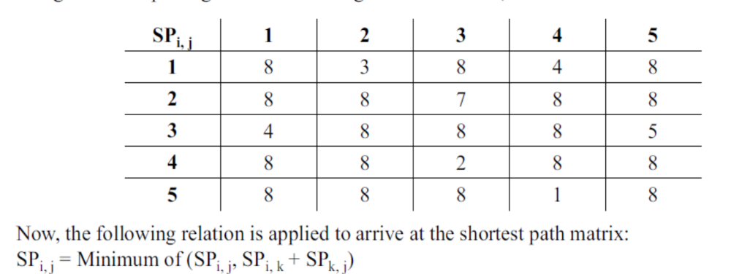

Slide 44
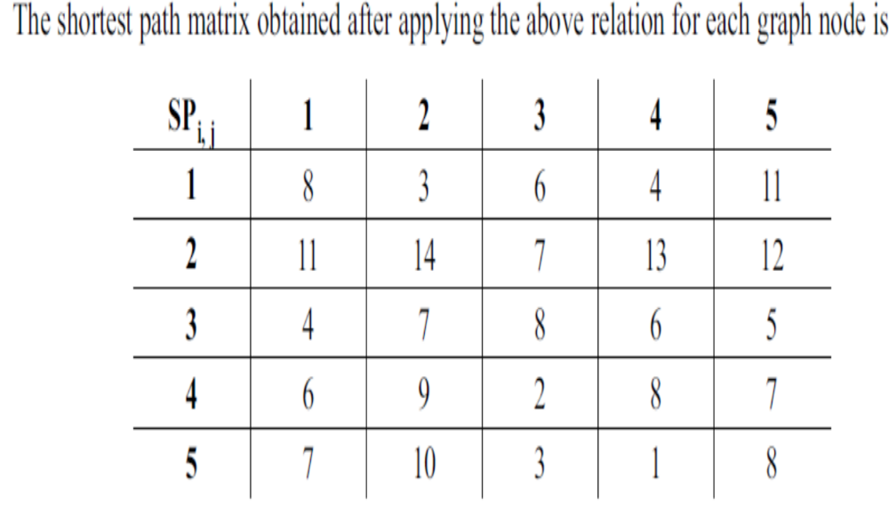

Slide 45
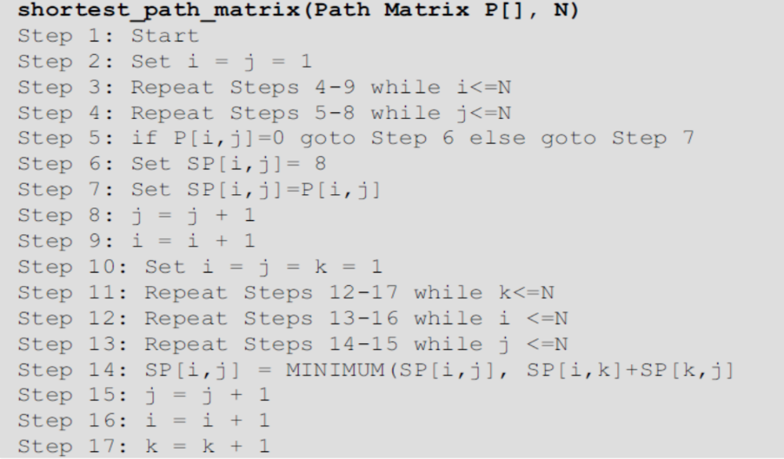

Slide 46
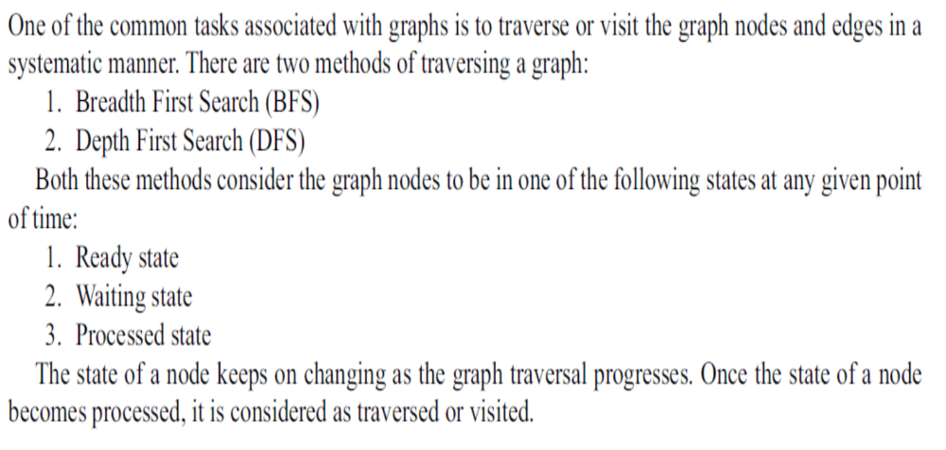
GRAPH TRAVERSAL

Slide 47
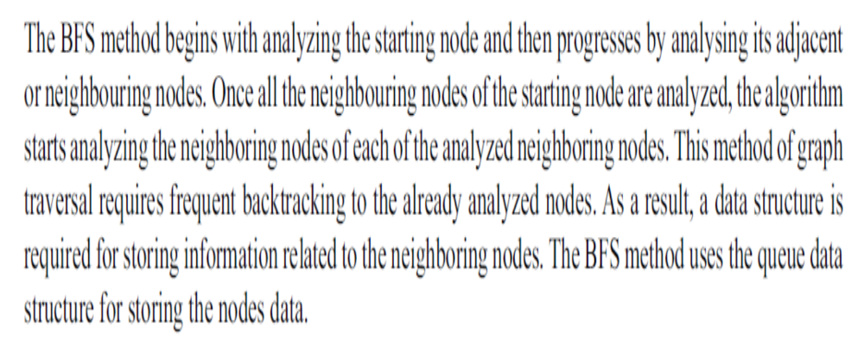
Breadth First Search

Slide 48
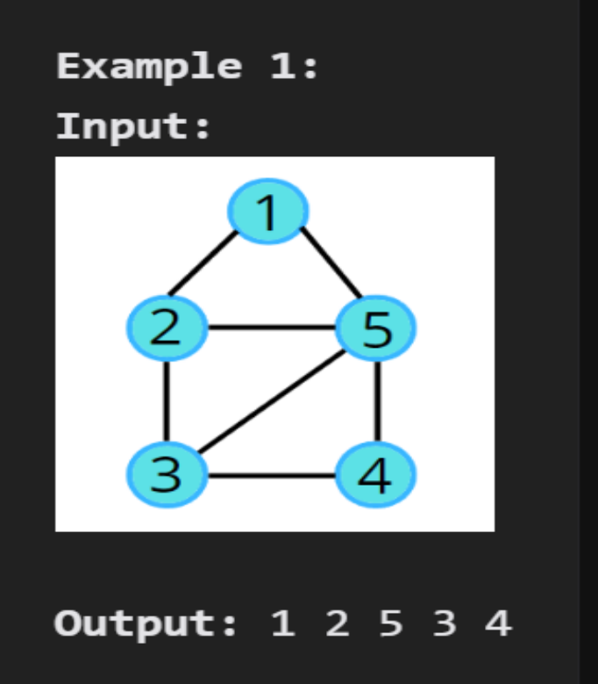
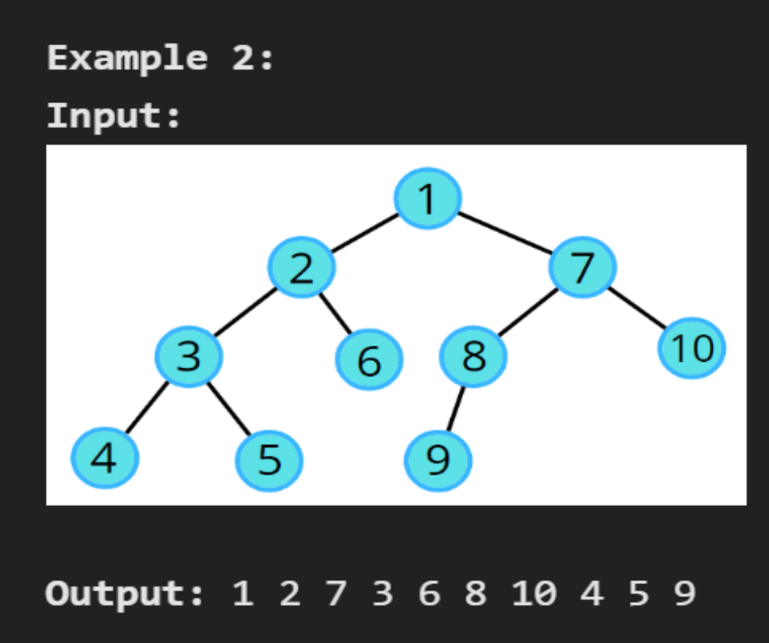
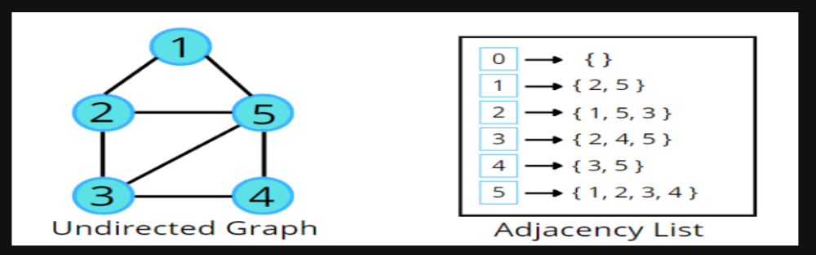

Slide 49
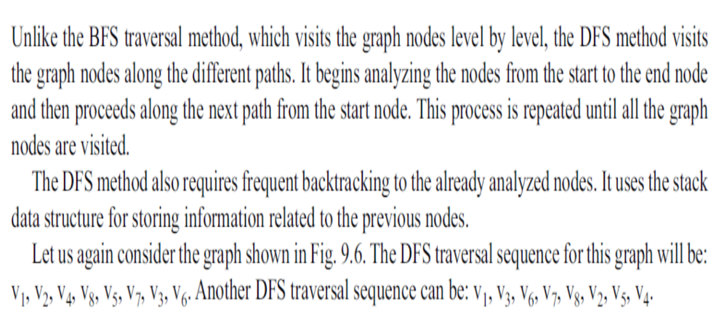
Depth First Search

Slide 50
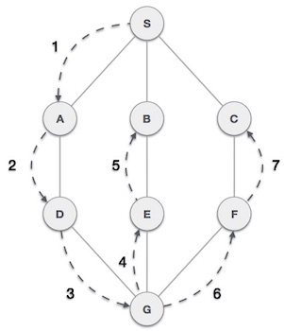

Slide 51
